Slide 1
Booker T. Washington vs. WEB DuBois
The future of African Americans

Slide 2
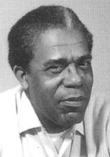
Booker T. and W.E.B. By Dudley Randall
"It seems to me," said Booker T., "It shows a mighty lot of cheek To study chemistry and Greek When Mister Charlie needs a hand To hoe the cotton on his land, And when Miss Ann looks for a cook, Why stick your nose inside a book?" "I don't agree," said W.E.B. "If I should have the drive to seek Knowledge of chemistry or Greek, I'll do it. Charles and Miss can look Another place for hand or cook, Some men rejoice in skill of hand, And some in cultivating land, But there are others who maintain The right to cultivate the brain."

Slide 3
"It seems to me," said Booker T., "That all you folks have missed the boat Who shout about the right to vote, And spend vain days and sleepless nights In uproar over civil rights. Just keep your mouths shut, do not grouse, But work, and save, and buy a house." "I don't agree," said W.E.B. "For what can property avail If dignity and justice fail? Unless you help to make the laws, They'll steal your house with trumped-up clause. A rope's as tight, a fire as hot, No matter how much cash you've got. Speak soft, and try your little plan, But as for me, I'll be a man." "It seems to me," said Booker T.-- "I don't agree," Said W.E.B.

Slide 4
Aim: Which ideas were better for African Americans, Washington or DuBois?
Vocab
Booker T. Washington
WEB DuBois
Essential Questions:
Why were African Americans in need of leadership?
Why were these ideas appealing to African Americans?
How did these ideas affect the future of Civil Rights?

Slide 5
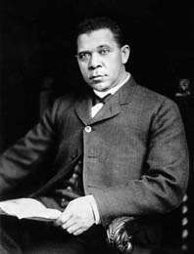
Booker T. Washington, 1856-1915

Slide 6
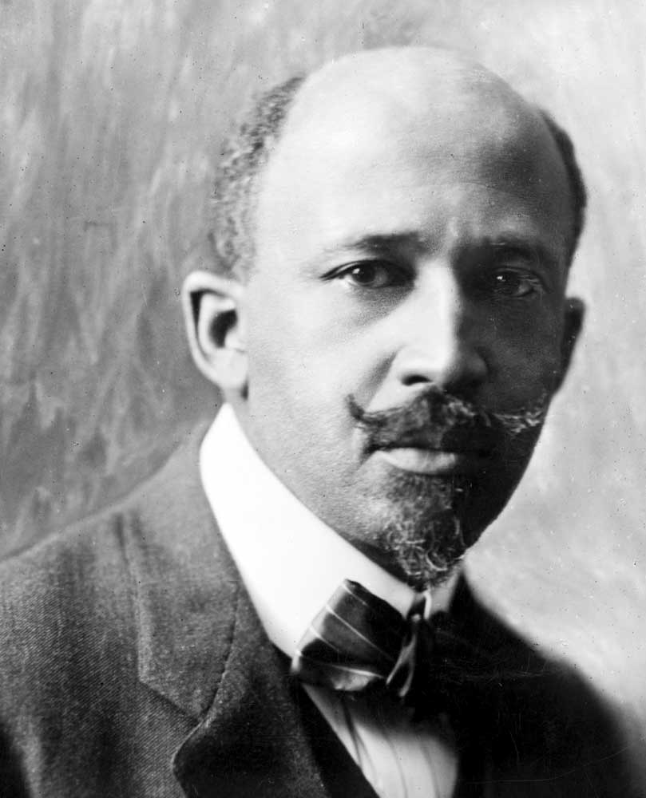
WEB DuBois,
1868-1963

Slide 7
Historian Eric Foner on Booker T. Washington and Conditions in the South
“…[T]alk of an individual route to advancement that eschewed political action in favor of economic self-help anticipated that fully developed conservative ideology associated with Booker T. Washington that would emerge in the post-Redemption South. Like Washington, conservative blacks during Reconstruction urged their constituents to seek out political alliances with ‘the Independent Conservative element of the South.’ And like him, they viewed an aggressive demand for equal access to public facilities as unrealistic and counterproductive.” (p.546)
“With politics eliminated as an avenue to power, and displays of militancy likely to be met by overwhelming force, ambitious and talented men in the black community found other outlets—education, business, the church, and the professions. During Reconstruction, political involvement, economic self help, and family and institution building had all formed parts of a coherent ideology of community advancement…. Severed from any larger political purpose, economic self help, especially among the emerging black middle class, became an alternative to involvement in public life.” (p. 598)

Slide 8
WEB DuBois on Booker T. Washington
“This brings us to the situation when Booker T. Washington became the leader of the Negro race and advised them to depend upon industrial education and work rather than politics. The better class of Southern Negroes stopped voting for a generation.” (p. 694)

Slide 9
Current problems facing the black community:
The annual income of African Americans who are employed in full-time jobs is 40% less than Whites
The Black unemployment rate is nearly double that of the whole nation.
One third of Blacks are poor, compared with just over 10 percent of Whites.
One half of all Black children live in poverty.
The infant mortality rate for Blacks is more than double that of Whites.
The proportion of Black male high school graduates who go on to college is lower today than in 1975.
More young Black males are in prison than in college.
Homicide is the leading cause of death for Black males between the ages of fifteen and thirty-four.
Although African Americans make up 12 percent of the population, they account for more than 35 percent of all AIDS cases.
The life expectancy of Black men is sixty-five years, a rate lower than any other group in America and comparable to that of some Third World countries.
Nearly 50 percent of all African American families are headed by single women.
Do you agree with the author that these problems faced by blacks today the result of blacks and the black organization of the NAACP adopting Du Bois’s ideas over Washington’s? Explain.

